Slide 1
WEB 3, Session 6
Server-client communication

Slide 2
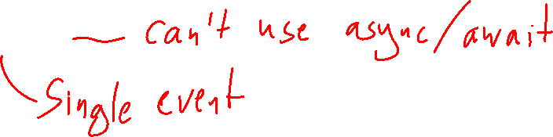
WebSockets
Like a socket but for HTTP
Has events open, message, closing, close
Listening for messages: Not blocking, but with event listeners (callbacks)
Cannot use promises

Slide 3
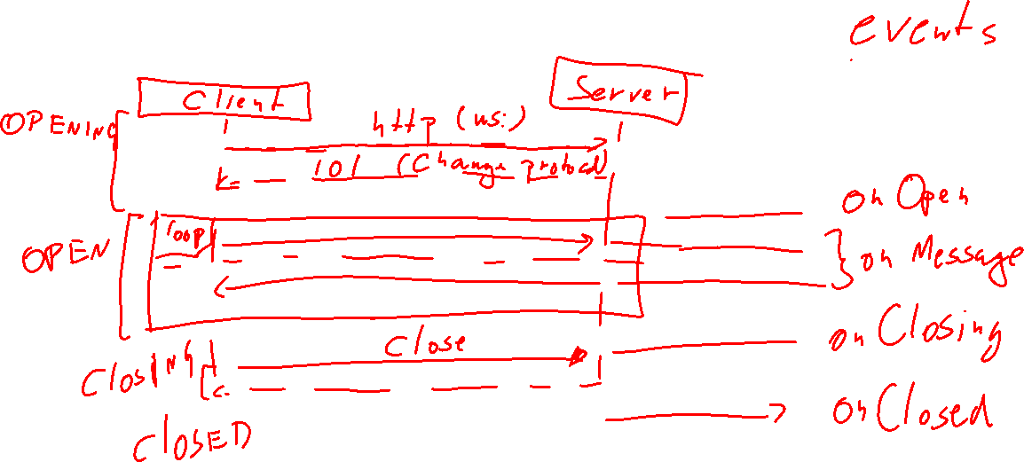
WebSocket protocol

Slide 4
WebSocket server
Need to install 'ws' in your project
'ws' has a WebSocketServer
Remember sockets?
The server waits (blocking) for a request
The request creates a dedicated socket for the client
WebSocketServer
Listens (non-blocking) for a request
The handler is given a dedicated web socket for the client

Slide 5
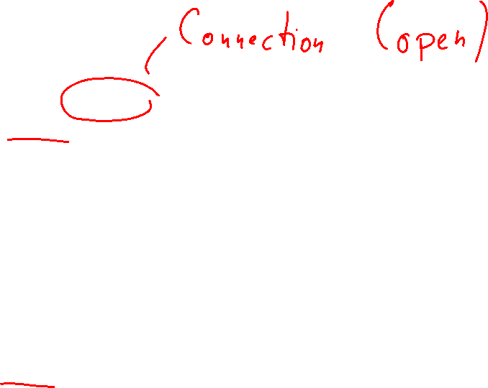
Code
webSocketServer.on('connection', (ws, req) => {
ws.on('message', message => {
try {
const { type, ...params } = JSON.parse(message.toString()) as Command
if (clients[type] !== undefined)
clients[type](params, ws)
else
console.error(`Incorrect message: '${message}' from ${req.socket.remoteAddress}`)
} catch (e) {
console.error(e)
}
})
ws.on('close', () => clients.close({}, ws))
})

Slide 6
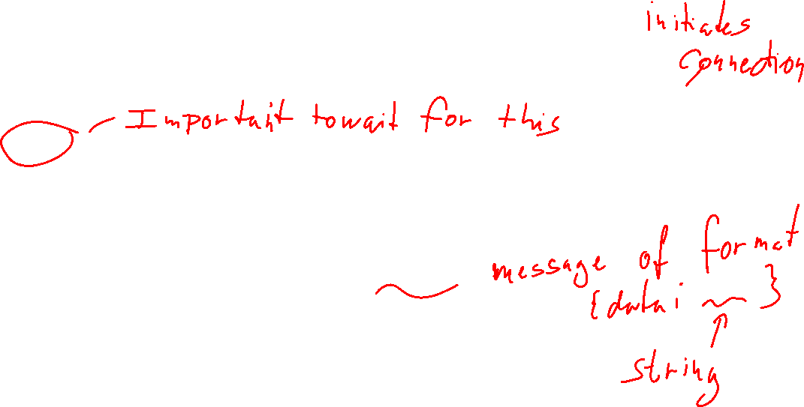
Client side example
const ws = new WebSocket('ws://localhost:9090/publish')
ws.onopen = () => ws.send(
JSON.stringify({
type: 'subscribe',
key: 'move_' + model.game.gameNumber}))
ws.onmessage = ({data}) => {
const {message: response} = JSON.parse(data)
…
}

Slide 7
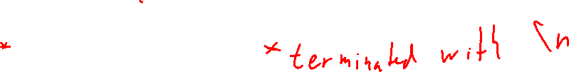
Server-sent Events
Uses HTTP 'keep-alive' connections
Websocket: Client and server can send to each other as needed
Server-side events: Server can send to client
You need a bit more manual handling of responses
Send a line with "data: <the data>"
Then send a blank line

Slide 8
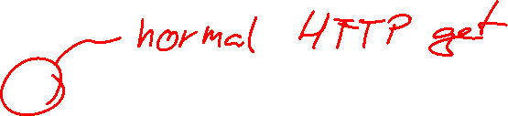
Headers (server-side)
gameserver.get('/games/:gameNumber/events', (req, res) => {
res.setHeader('Connection', 'keep-alive')
res.setHeader('Content-Type', 'text/event-stream')
res.setHeader('Cache-Control', 'no-cache')
...

Slide 9
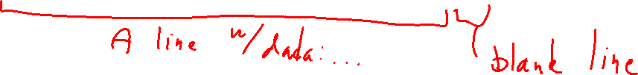
Sending events
res.write(`data: ${JSON.stringify(message)}\n\n`)

Slide 10
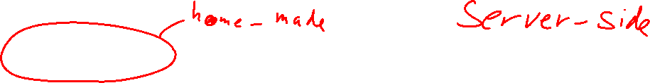
Reacting to connection closing (example)
const sub = subscriptions.subscribe(
res,
messageTypeResult.data,
gameNumberResult.data)
req.on('close', () => {
subscriptions.unsubscribe(sub.id)
})

Slide 11
Client-side
const events = new EventSource(
`http://localhost:8080/games/${gameNumber}/events?type=move`
)
events.onmessage = ({data}) => {
const message = JSON.parse(data)
// Handle message here
}
// When done: events.close()

Slide 12
Code
tic-tac-toe-server-sent-events
gameserver.ts
tic-tac-toe-sse-client
Lobby.vue
Waiting.vue
ActiveGame.vue

Slide 13
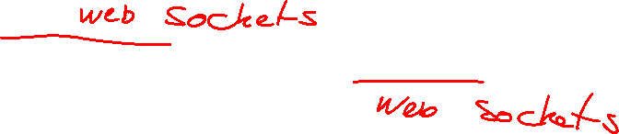
GraphQL Subscriptions
Not implemented in every package
Is implemented in Apollo Server/Client
Uses webservices to communicate
we don't have to do much to set webservices up.
Use a library to manage the communication
We'll be using PubSub
A part of the package 'graphql-subscriptions'
Maintains an in-memory queue of messages
In production, we would prefer a persistent queue

Slide 14
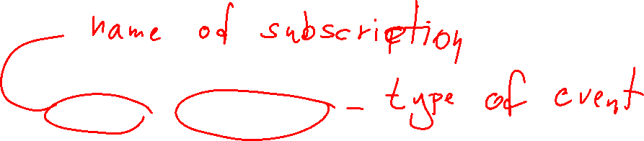
GraphQL definition (.sdl)
type Subscription {
active: ActiveGame,
pending: PendingGame
}

Slide 15
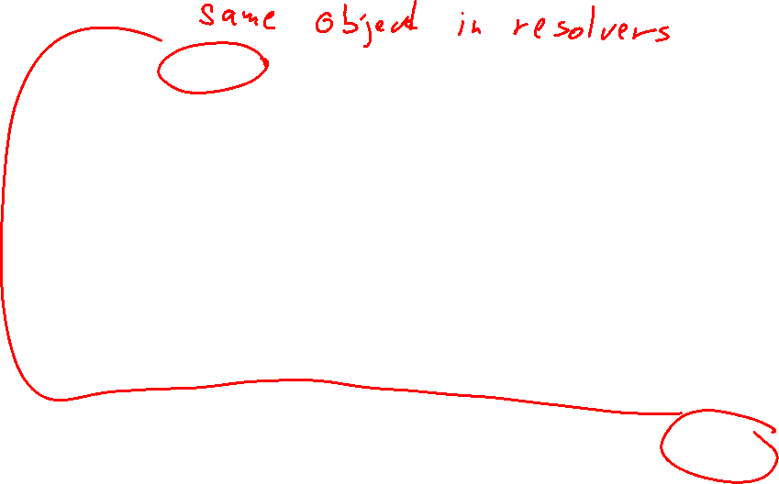
Creating and using PubSub
const pubsub: PubSub = new PubSub()
async send(game: PendingGame | IndexedYahtzee) {
if (game.pending) {
pubsub.publish('PENDING_UPDATED', {pending: game})
} else {
pubsub.publish('ACTIVE_UPDATED', {active: game})
}
}
const resolvers = create_resolvers(pubsub, api)

Slide 16
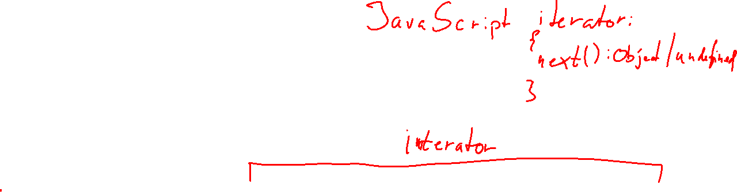
Resolvers
{
…
Subscription: {
active: {
subscribe: () => pubsub.asyncIterableIterator(['ACTIVE_UPDATED'])
},
pending: {
subscribe: () => pubsub.asyncIterableIterator(['PENDING_UPDATED'])
}
}
}

Slide 17
Client-side – setting up the client (I)
const wsLink = new GraphQLWsLink(createClient({
url: 'ws://localhost:4000/graphql',
}))
const httpLink = new HttpLink({
uri: 'http://localhost:4000/graphql'
})

Slide 18

Client-side – setting up the client (II)
const splitLink = split(
({ query }) => {
const definition = getMainDefinition(query)
return (
definition.kind === 'OperationDefinition' &&
definition.operation === 'subscription'
)
},
wsLink,
httpLink,
)

Slide 19
Client-side – setting up the client (III)
const apolloClient = new ApolloClient({
link: splitLink,
cache: new InMemoryCache()
})

Slide 20
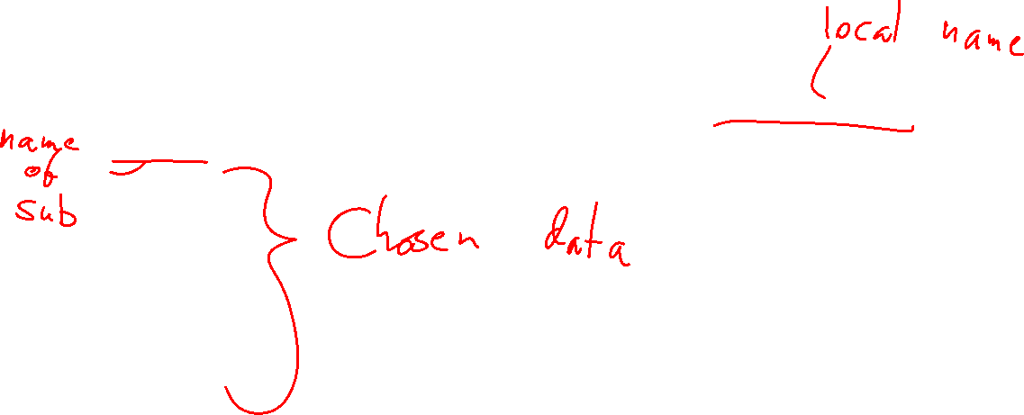
Using the client (I)
const gameSubscriptionQuery = gql`subscription GameSubscription {
active {
id
…
scores {
slot
score
}
}
}`

Slide 21

Using the client (II)
const gameObservable = apolloClient.subscribe({
query: gameSubscriptionQuery
})
gameObservable.subscribe({
next({data}) {
const game = data.active
…
},
error(err) {
console.error(err)
}
})

Slide 22
Zod

Slide 23
Why Zod?
TypeScript types gives us some safety, but they are gone at runtime
Particularly a problem with
User input
Data coming in to webservices
Zod allows us to
Validate the data
Get data that we know the type of
Use typescript types generated by Zod

Slide 24
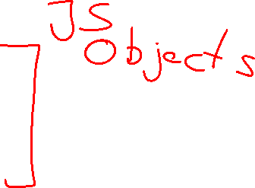
Defining primitives
import * as z from 'zod'
z.number()
z.boolean()
z.string()
…

Slide 25
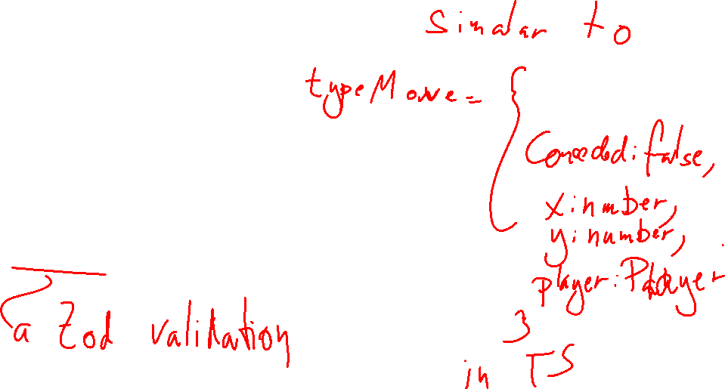
Defining objects
z.object({
conceded: z.literal(false),
x: z.number(),
y: z.number(),
player: Player
})

Slide 26
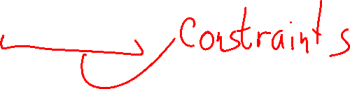
Defining arrays
const Row = z.array(
z.object({
x: z.number(),
y: z.number(),
})
)
const Board = z.array(
z.array(Tile).length(3)
).length(3)

Slide 27
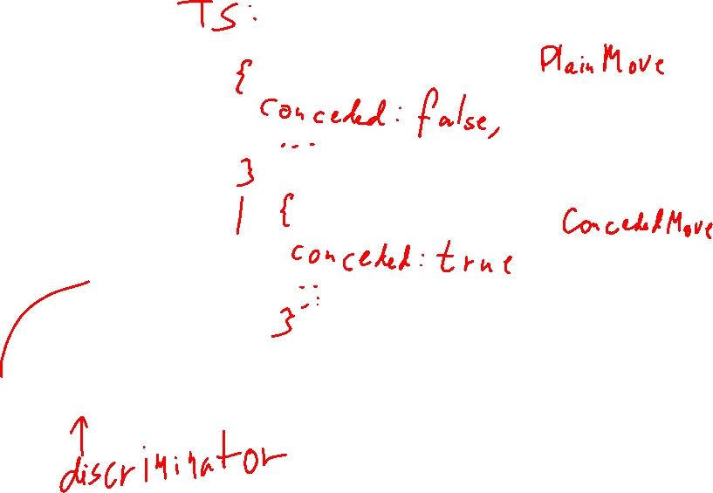
Specialities
z.enum(['X', 'O'])
z.nullable(Player)
z.literal(true)
z.discriminatedUnion("conceded", [PlainMove, ConcededMove])

Slide 28
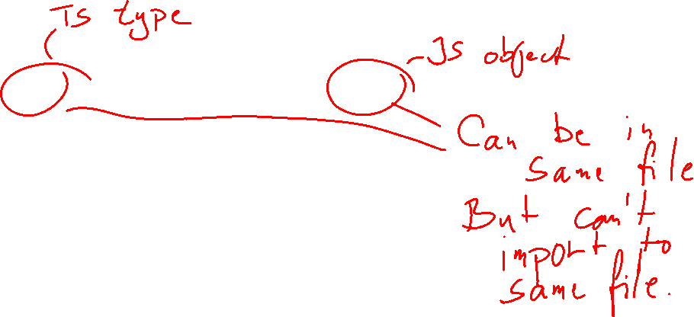
Types
export type Player = z.infer<typeof Player>
export type Tile = z.infer<typeof Tile>
export type Board = z.infer<typeof Board>
export type Move = z.infer<typeof Move>
export type WinState = z.infer<typeof WinState>
export type GameData = z.infer<typeof GameData>

Slide 29
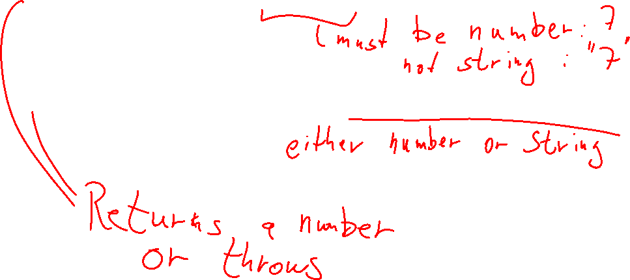
Enforcing validation rules
z.number().parse(req.body)
z.coerce.number().parse(req.params.gameNumber)

Slide 30
Error handling with exceptions
try {
z.coerce.number().parse(…)
} catch (e) {
…
}

Slide 31
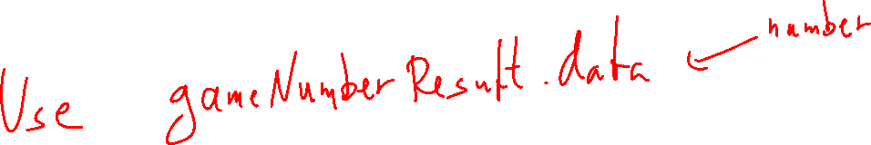
Error handling with result pattern
const gameNumberResult =
z.coerce.number().safeParse(req.params.gameNumber)
if (!gameNumberResult.success) {
res.status(400).send(z.prettifyError(gameNumberResult.error))
return
}

Slide 32
Code
tic-tac-toe-server-sent-events
validation.ts
model.ts
gameserver.ts

